Slide 1
Cloud Computing
SEWP ZG527

Slide 2
What is OpenNebula?
Notes:
RL 6.3

Slide 3
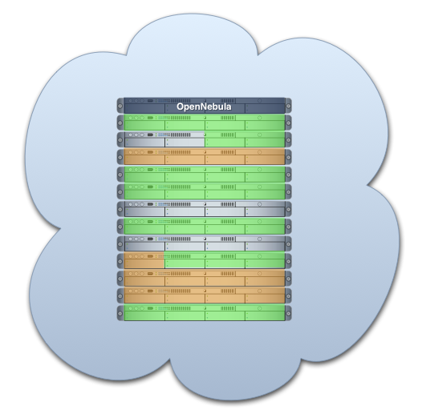


What is OpenNebula?
Enabling Technology to Build your Cloud
Private Cloud to simplify and optimize internal operations
Hybrid Cloud to supplement the capacity of the Private Cloud
Public Cloud to expose your Private to external users

Slide 4



What is the OpenNebula Open-Source Project?
Building the Industry Standard Open Source Cloud Computing Tool
Lead Innovation in Enterprise-Class Cloud Computing Management
Develop, maintain and assure the quality of OpenNebula
Collaborate with open-source and research projects and communities
Support the community and the ecosystem
An Active and Engaged Community
4,000 downloads/month
100 active contributors
OSS distribution channels
From a Research Project on Scalable Management of VMs:
Research
Project
v3.0
v3.4
TP1
v1.0
v1.2
v1.4
v2.0
v2.2
v3.2
2005 2006 2007 2008 2009 2010 2011 2012
European Funding

Slide 5
The Benefits of OpenNebula
For the Infrastructure Manager
Centralized management of VM workload and distributed infrastructures
Support for VM placement policies: balance of workload, server consolidation…
Dynamic resizing of the infrastructure
Dynamic partition and isolation of clusters
Dynamic scaling of private infrastructure to meet fluctuating demands
Lower infrastructure expenses combining local and remote Cloud resources
For the Infrastructure User
Faster delivery and scalability of services
Support for heterogeneous execution environments
Full control of the lifecycle of virtualized services management
Notes:
OpenNebula provides benefits for different stakeholders
For service managers, it provides
We will talk about this later, related to Green IT
Provides an open…
This allows its integration… cloud providers (we now have support for EC2 and EH), hypervisors (we have support for Xen, KVM), we provide our own VM image manager but…

Slide 6
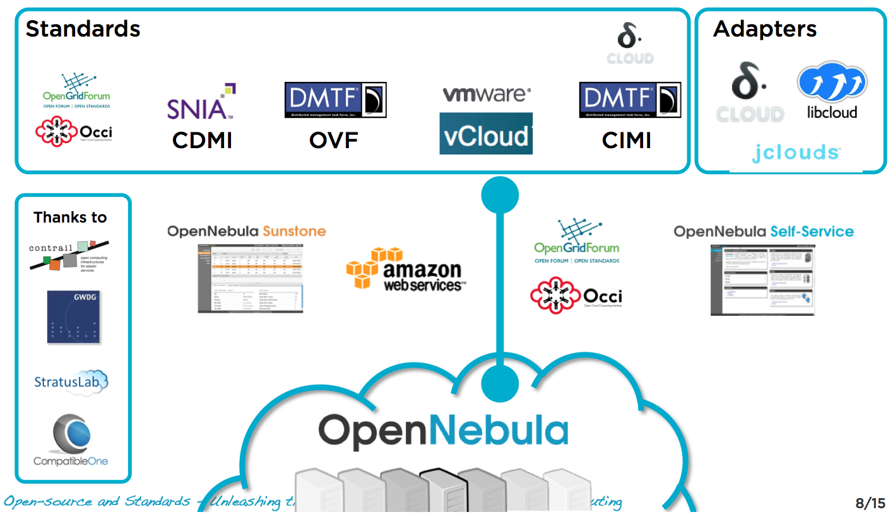
Interoperability From the Cloud Consumer Perspective
Standards (de facto and de jure) and adapters can be used to leverage existing ecosystems and ensure portability across providers....

Slide 7
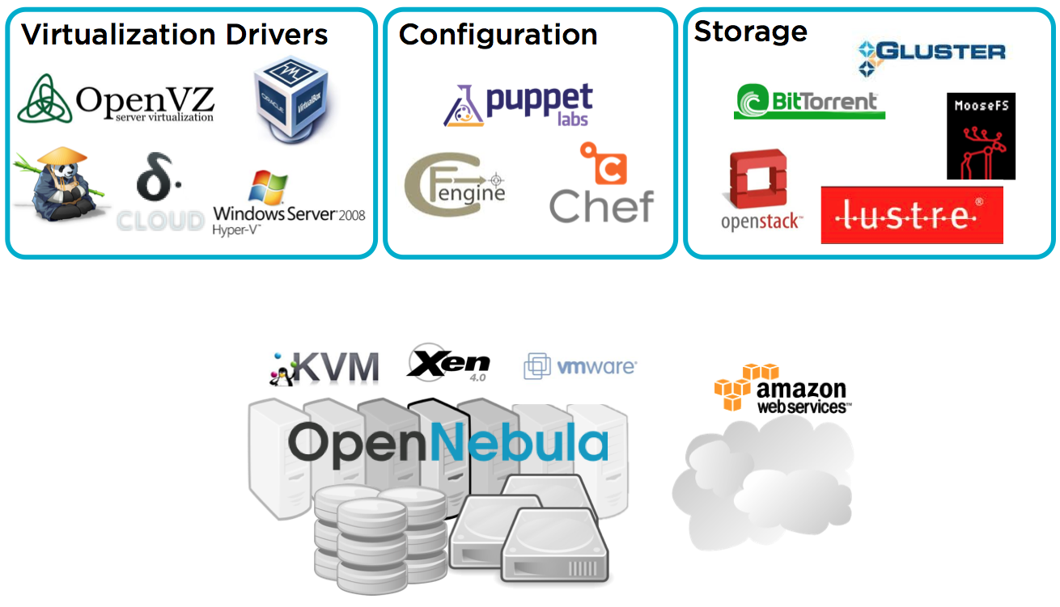
Interoperability from the Cloud Provider perspective
Interoperable (platform independent), innovative (feature-rich) and proven (mature to run in production).

Slide 8
The Benefits for System Integrators
Fits into any existing data center, due to its open, flexible and extensible interfaces, architecture and components
Builds any type of Cloud deployment
Open source software, Apache license
Seamless integration with any product and service in the cloud ecosystem and management tool in the data center, such as
cloud providers
VM managers
virtual image managers
service managers
management tools
schedulers
Notes:
OpenNebula provides benefits for different stakeholders
For service managers, it provides
We will talk about this later, related to Green IT
Provides an open…
This allows its integration… cloud providers (we now have support for EC2 and EH), hypervisors (we have support for Xen, KVM), we provide our own VM image manager but…

Slide 9
The main features of OpenNebula
Feature | Function
Internal Interface | Unix-like CLI for fully management of VM life-cycle and physical boxes XML-RPC API and libvirt virtualization API
Scheduler | Requirement/rank matchmaker allowing the definition of workload and resource-aware allocation policies Support for advance reservation of capacity through Haizea
Virtualization Management | Xen, KVM, and VMware Generic libvirt connector (VirtualBox planned for 1.4.2)
Image Management | General mechanisms to transfer and clone VM images
Network Management | Definition of isolated virtual networks to interconnect VMs
Service Management and Contextualization | Support for multi-tier services consisting of groups of inter-connected VMs, and their auto-configuration at boot time
Security | Management of users by the infrastructure administrator
Fault Tolerance | Persistent database backend to store host and VM information
Scalability | Tested in the management of medium scale infrastructures with hundreds of servers and VMs (no scalability issues has been reported)
Flexibility and Extensibility | Open, flexible and extensible architecture, interfaces and components, allowing its integration with any product or tool
Notes:
Three types of features according to the different deployment models
About features…

Slide 10
Comparison with Similar Technologies
 | Platform ISF | VMware Vsphere | Eucalyptus | Nimbus | OpenNebula
Virtualization Management | VMware, Xen | VMware | Xen, KVM | Xen | Xen, KVM, VMware
Virtual Network Management | Yes | Yes | No | Yes | Yes
Image Management | Yes | Yes | Yes | Yes | Yes
Service Contextualization | No | No | No | Yes | Yes
Scheduling | Yes | Yes | No | No | Yes
Administration Interface | Yes | Yes | No | No | Yes
Hybrid Cloud Computing | No | No | No | No | Yes
Cloud Interfaces | No | vCloud | EC2 | WSRF, EC2 | EC2 Query, OGF OCCI
Flexibility and Extensibility | Yes | No | Yes | Yes | Yes
Open Source | No | No | GPL | Apache | Apache

